Slide 1

jarred capellman | 4.19.2019

Slide 2


DREAM
REALITY

Slide 3





Slide 4


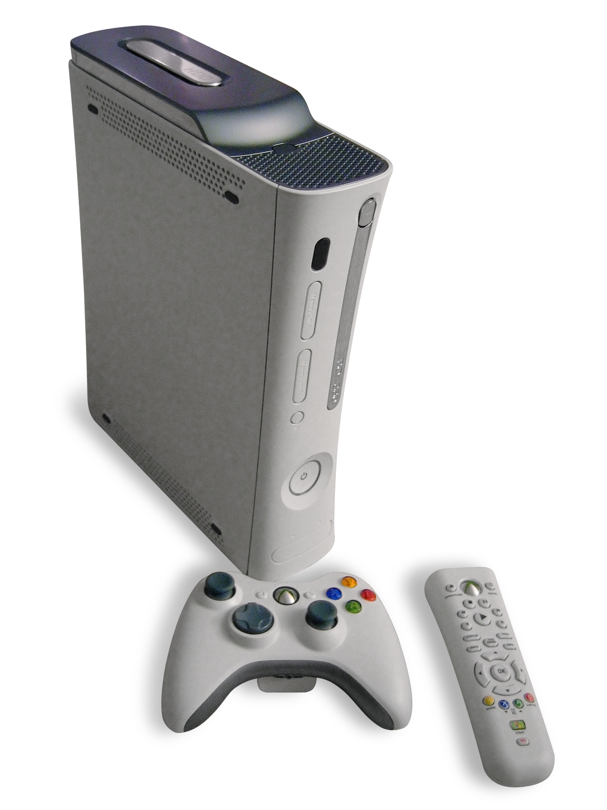
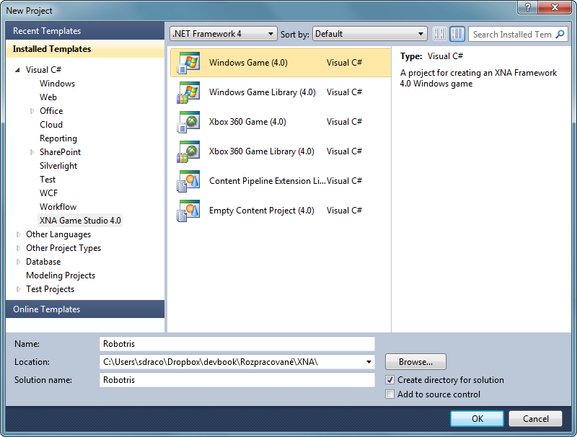




What is MonoGame?
Originally based on XNA
Started in 2009
Handles
2D
3D
Sound
Input
Effects

Slide 5
How does Unity compare?
Unity offers a ready to go engine for 2D or 3D
Complexities of 2D might supersede MonoGame depending on the game
Documentation, Examples and Assets are plentiful
MonoGame is lacking in this regard
Licensing Model is Free up to 100k
MonoGame is MIT License

Slide 6








Targeted platforms
*PS4, Xbox One and Nintendo Switch require developer program registration

Slide 7


Published MonoGame Titles (1000+)

Slide 8
MonoGame Structure
Content Pipeline
Game Class
Rendering
Input
Updates

Slide 9
Game Class
public class Game : IDisposable {
protected virtual void Initialize();
protected virtual void LoadContent();
protected virtual void Update(GameTime time);
protected virtual void Draw(GameTime time);
}

Slide 10
LoadContent
private Texture2D playerSprite;
protected override void LoadContent() {
playerSprite = Content.Load<Texture2D>(“PlayerSprite”);
}

Slide 11
Draw
private Texture2D playerSprite;
protected override void Draw(GameTime gameTime) {
graphics.GraphicsDevice.Clear(Color.Black);
spriteBatch.Begin();
spriteBatch.Draw(playerSprite, Vector.One, Color.White);
spriteBatch.End();
}

Slide 12
Update
protected override void Update(GameTime gameTime) {
if (keyboardState.IsKeyDown(Keys.Up)) {
// Handle movement
}
// Handle other keys
}

Slide 13
CREATING A GAME WITH MONOGAME

Slide 14
High Level Game Design Questions
Perspective
2D
3D
Control Mechanisms
Mouse
Keyboard
Controller
Targeted platforms
Mobile
Console
Desktop

Slide 15

Things to keep in mind
Resolution Scaling
Use Highest Resolution Assets available
Architect up front
Long term time savings
Playtest early and often
Tooling <- Do it early

Slide 16
MonoGame Resources
A new book coming later this year (From beginner to advanced)
GitHub:
https://github.com/MonoGame/MonoGame.Samples

Slide 17
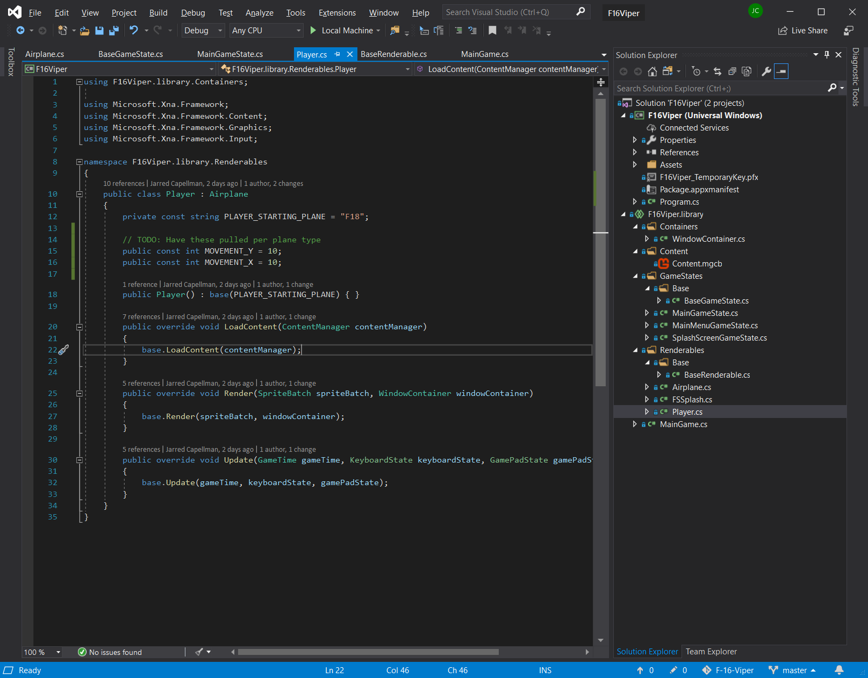
demo | code deep dive

